Slide 1
Mapping the Indefinable: Using Social Network Analysis to Visualize East-West Exchanges’ Effects on Poland’s Political Development
Gregory F. Domber, California Polytechnic State University, San Luis Obispo
In collaboration with: Kelly Bodwin (Ass’t Professor of Statistics) and Russ White (Data and GIS Specialist), Cal Poly
Supported by the Smith Richardson Foundation

Slide 2
Current Research Question:
Did East-West exchanges shape or influence the Round Table negotiations in Poland in 1989? If so, how?
Notes:
Talk about all of the anecdotal information I came across about the importance of long-standing

Slide 3
Possible Models to Follow
Examples:
Giles Scott-Smith on IVLP
Matt Evangelista on Pugwash Conferences
Robert English on a “Westernizing” view in the USSR
Igor Czernecki on Ford Foundation and Polish Sociology
Common Traits
Epistemic communities
Episodic, defined groups
Qualitative analysis with theoretical insights
Notes:
Talk about the examples and what they share in common. Talk about the limits of this approach.

Slide 4
U.S. Polish Exchange Programs, 1956-1990
Government Sponsored:
Non-Governmental:
J. William Fulbright Program
International Visitor Leadership Program (IVLP)
National Science Foundation (NSF)
Hubert Humphrey Fellowship Program
Ford Foundation
Rockefeller Foundation
Brethren Church
Kosciuszko Foundation
International Research and Exchanges Board (IREX)
Individual University Exchanges
Notes:
How do you create a more holistic picture when the picture of exchanges is so much more complex than just these individual group

Slide 5
The Quantitative Approach: Social Network Analysis (SNA)
Two overlapping networks:
1) Exchange participants
2) Round Table Participants
Notes:
Speak briefly about the origins of social network analysis. Talk about the concept/idea of creating a social network of the opposition and the

Slide 6
How to Quantify a Life?
Institutional Affiliations
Places of work
Educational history
Connection to publishers and publications/samizdat
Party and government positions
Opposition and independent society positions
Events (protests, strikes, agreements, negotiations, open letters. . . )
Notes:
Talk about the concept of institutional affiliations. Talk about the key sources I used to create this database. Can be historically recreated. Then break from the slideshow to show the actual database entry on Jacek Kuroń.
Then go into a discussion of the Shiny App and go through the patterns that I saw in the January/June spins, ending with the big clump in the 1980s.
Then go into an exploration of the actual SNA application. Talk about this as confirming what we might expect about the development of the opposition. So the application seems to hold some relevance.
The most interesting thing to actually follow are the unexpected connection points, where the different groups come together.

Slide 7
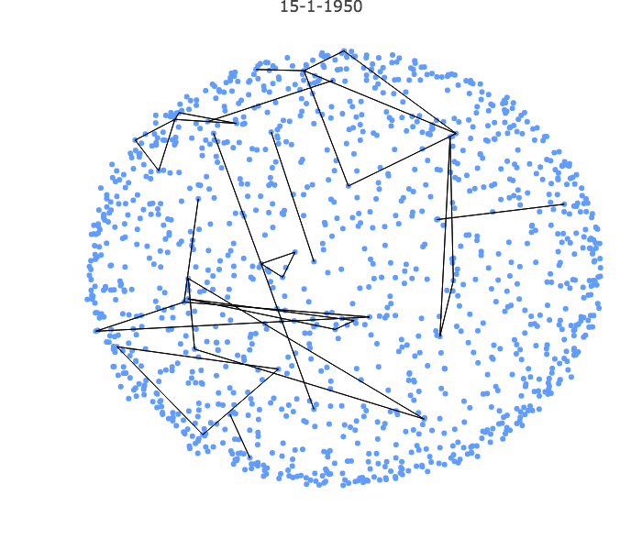

Slide 8
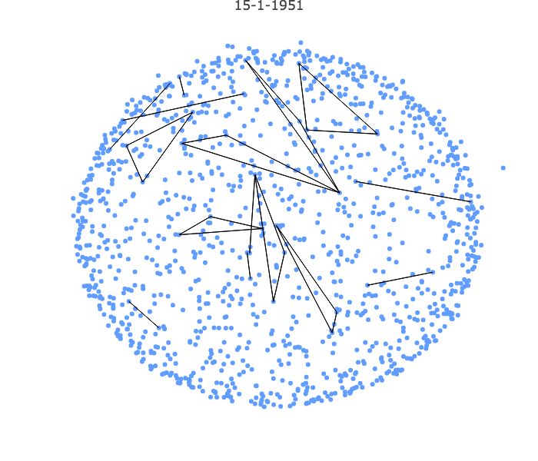

Slide 9
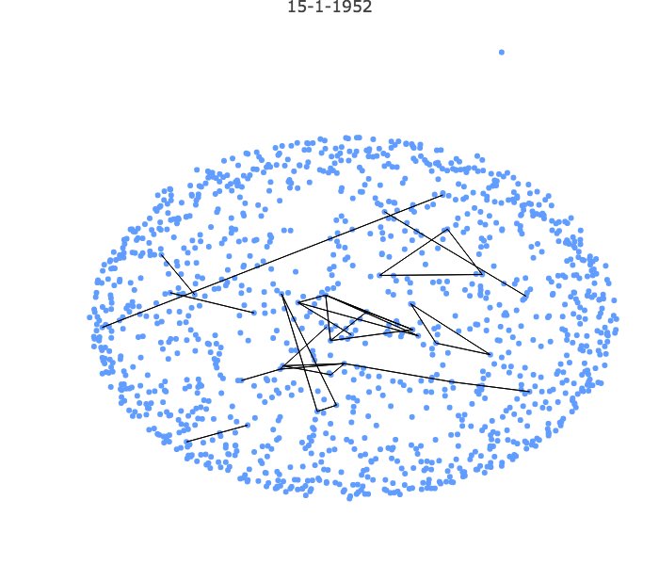

Slide 10
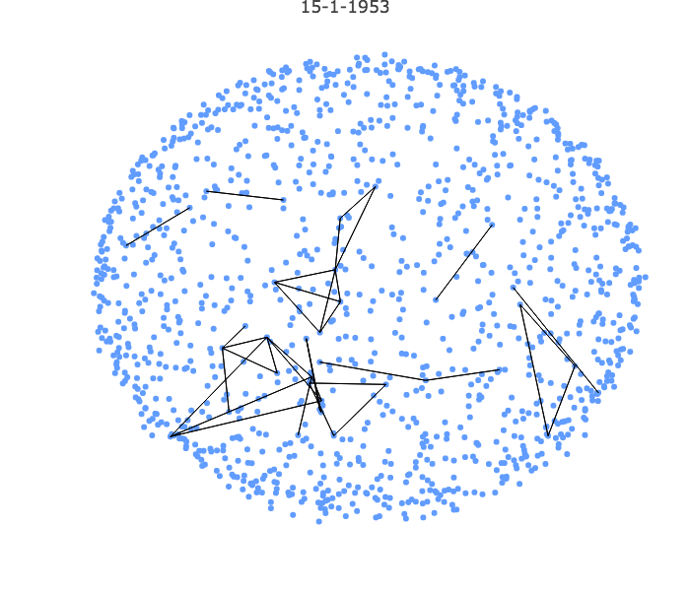

Slide 11
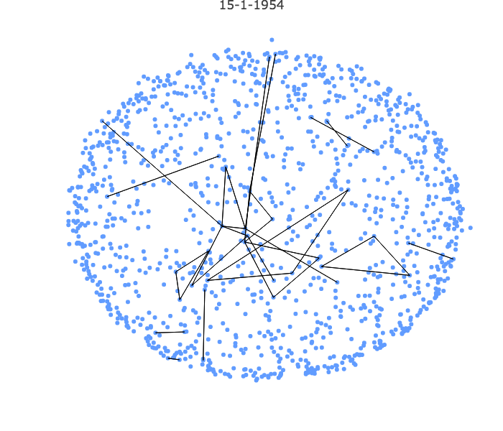

Slide 12
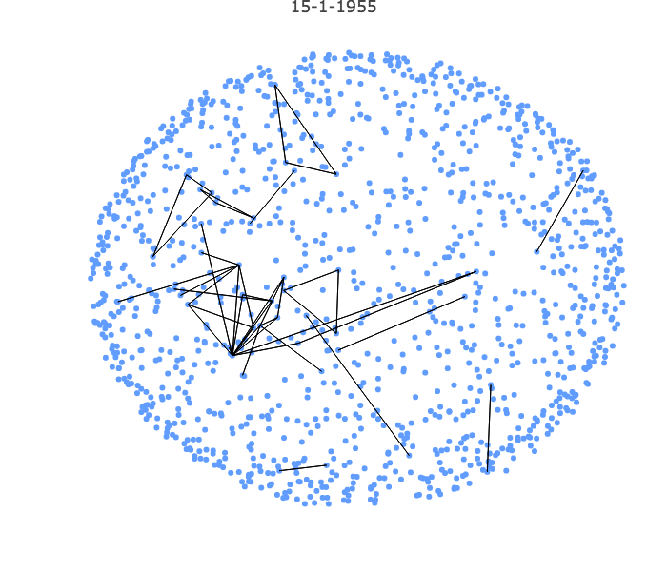

Slide 13
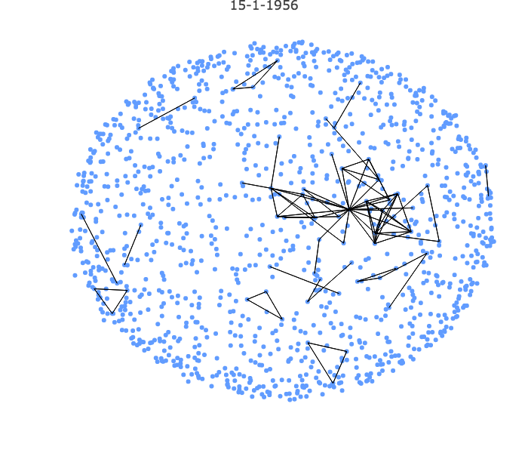

Slide 14
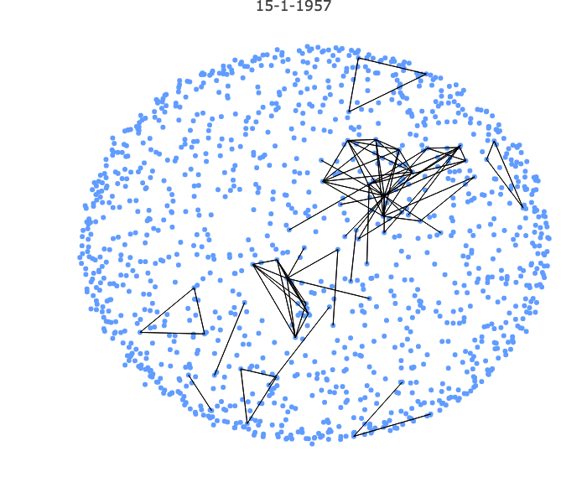

Slide 15
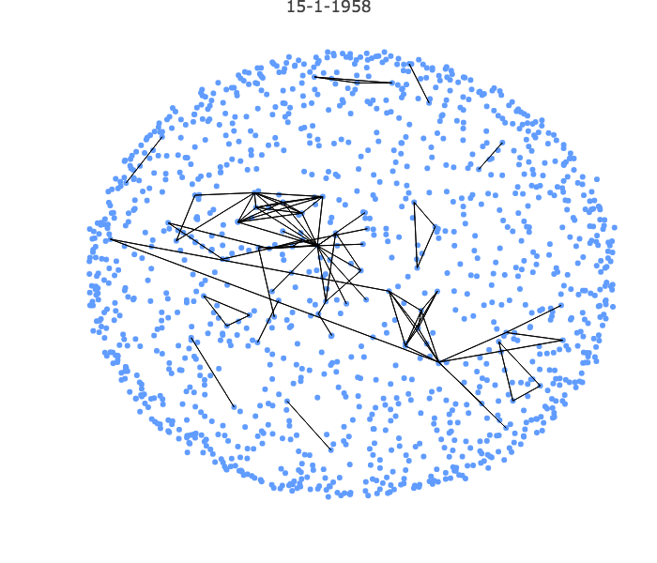

Slide 16
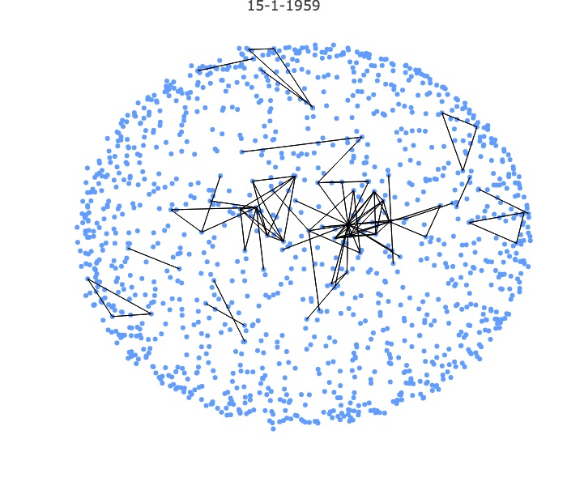

Slide 17
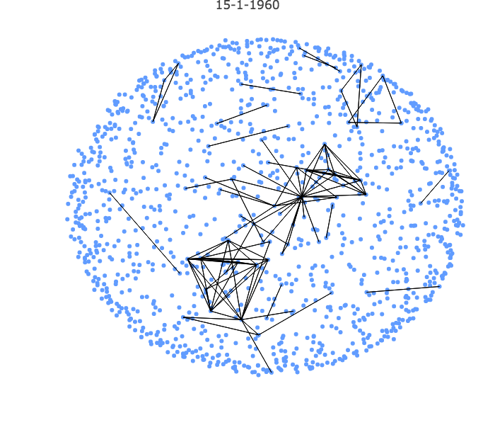

Slide 18
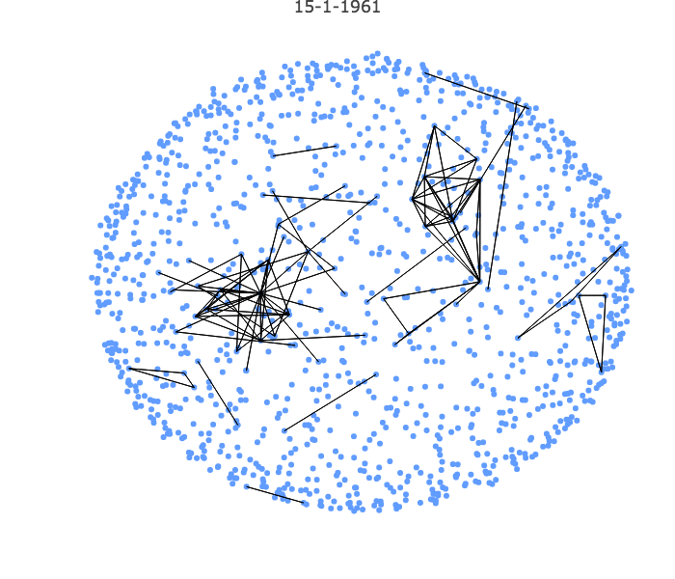

Slide 19
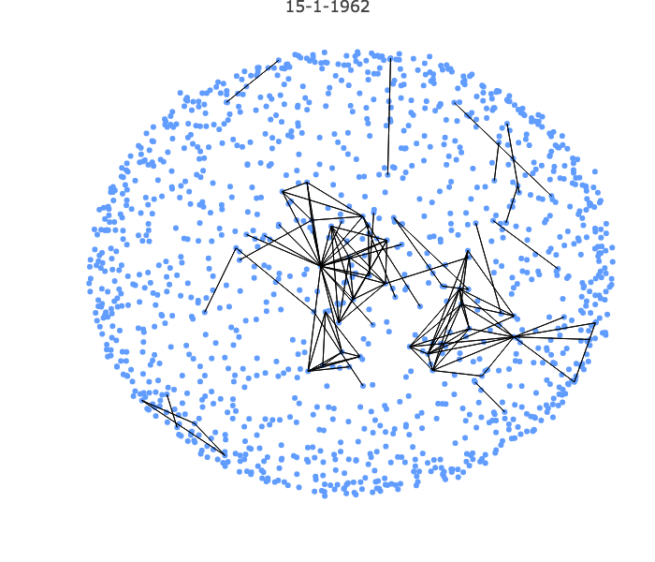

Slide 20
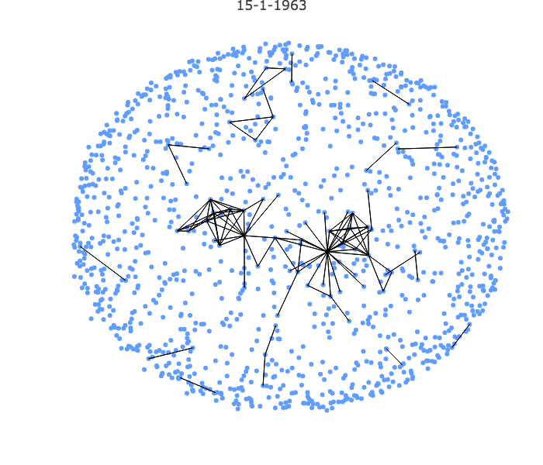

Slide 21
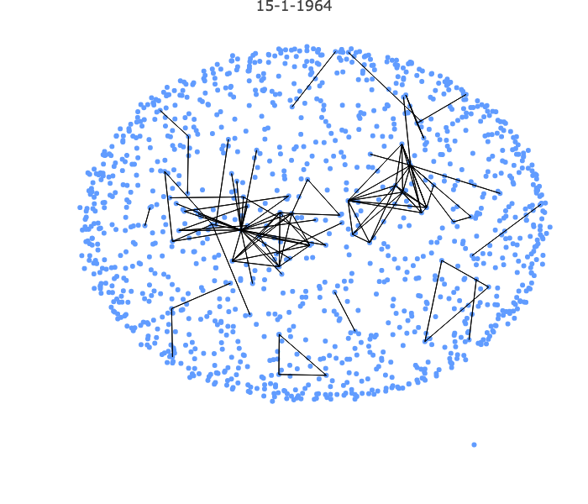

Slide 22
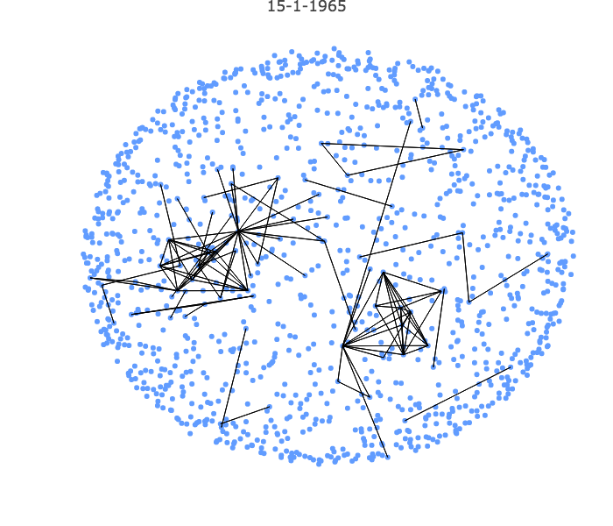

Slide 23
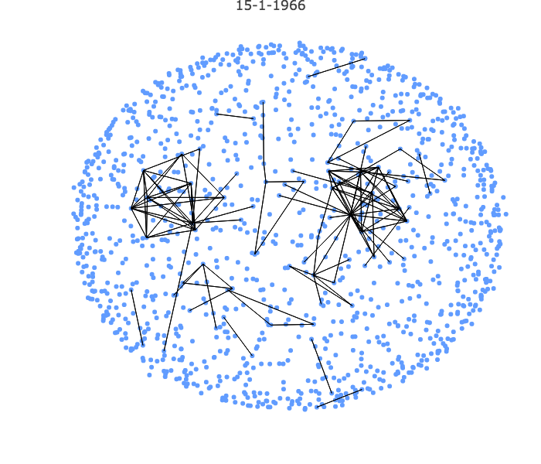

Slide 24
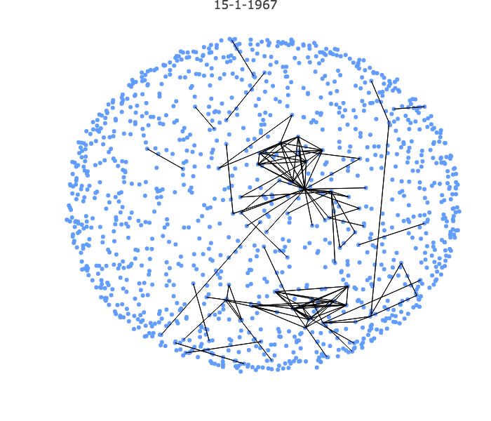

Slide 25
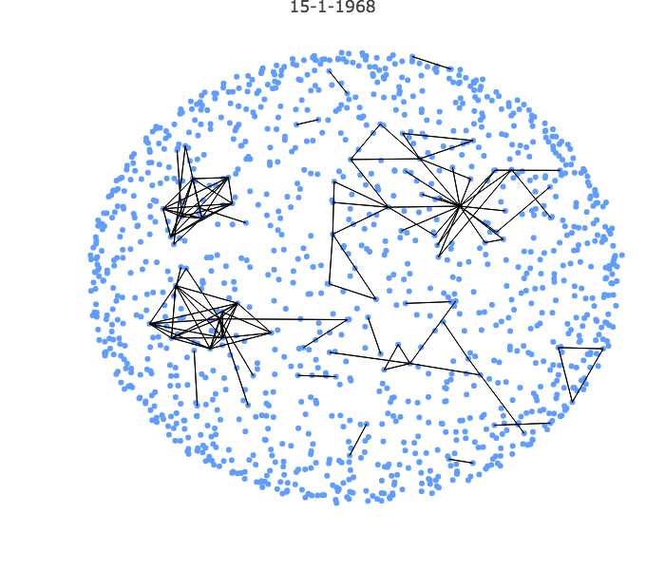

Slide 26
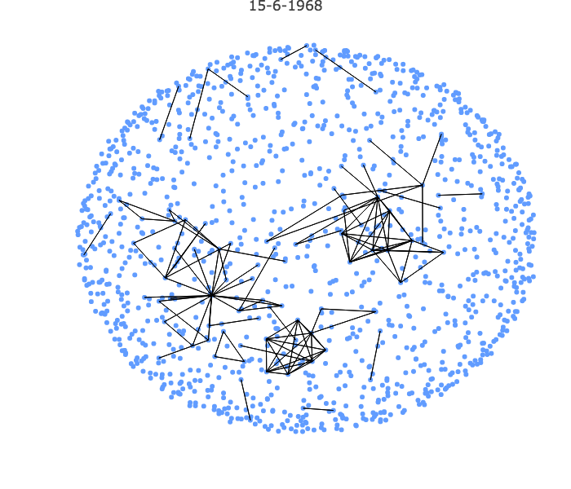

Slide 27
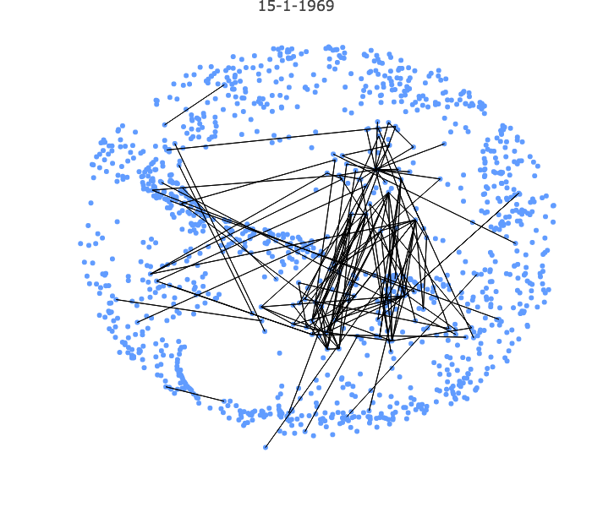

Slide 28
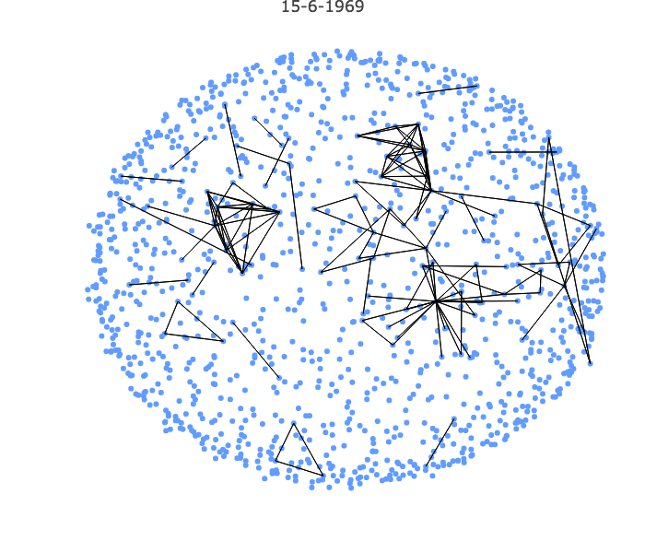

Slide 29
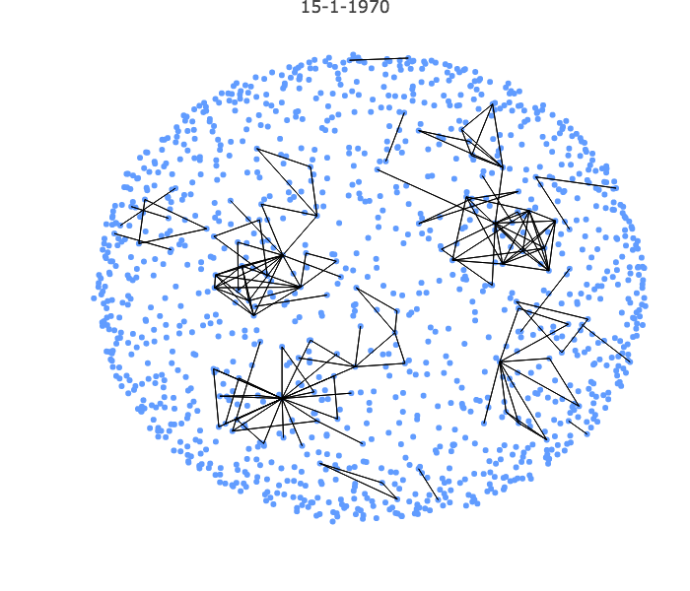

Slide 30
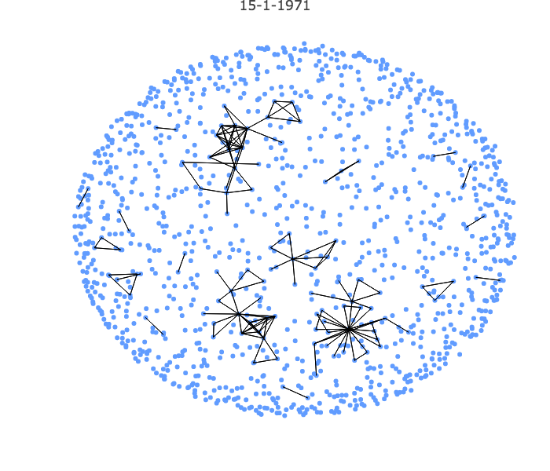

Slide 31
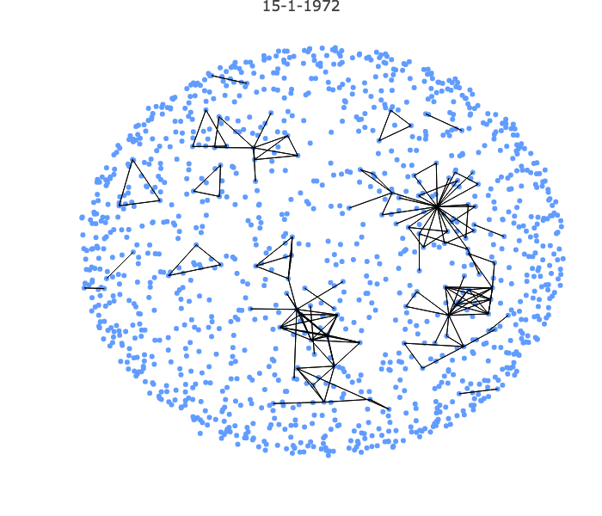

Slide 32
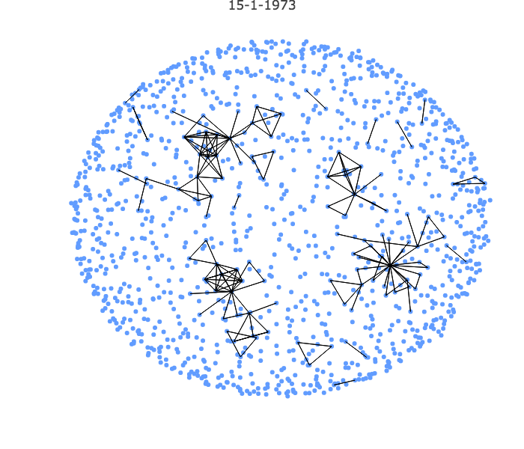

Slide 33
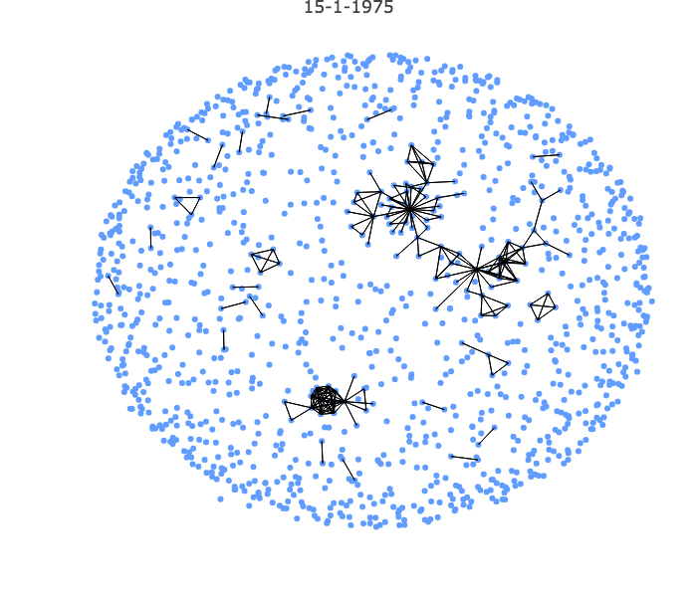

Slide 35
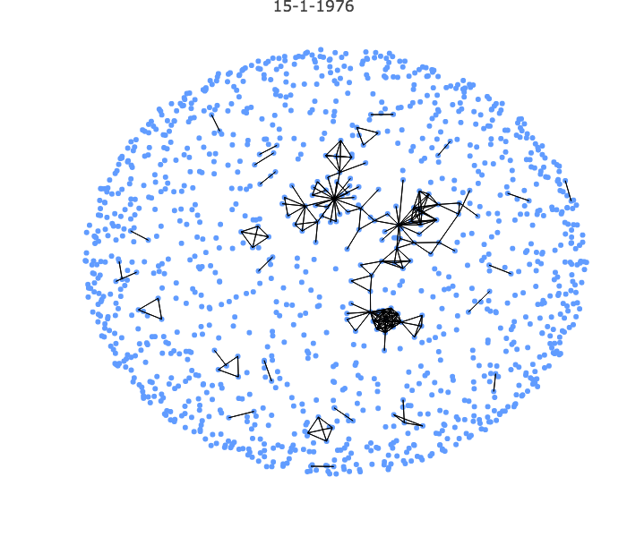

Slide 36
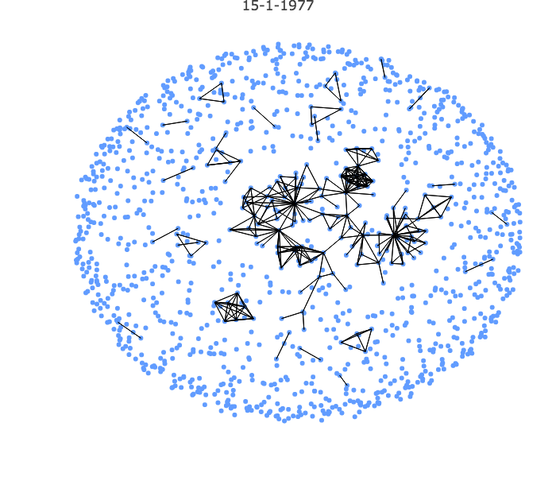

Slide 37
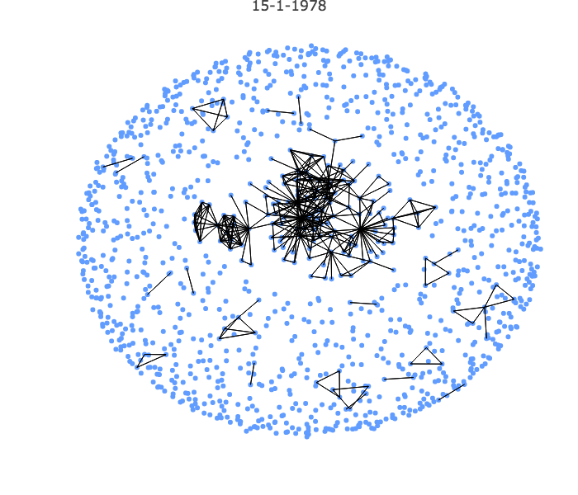

Slide 38
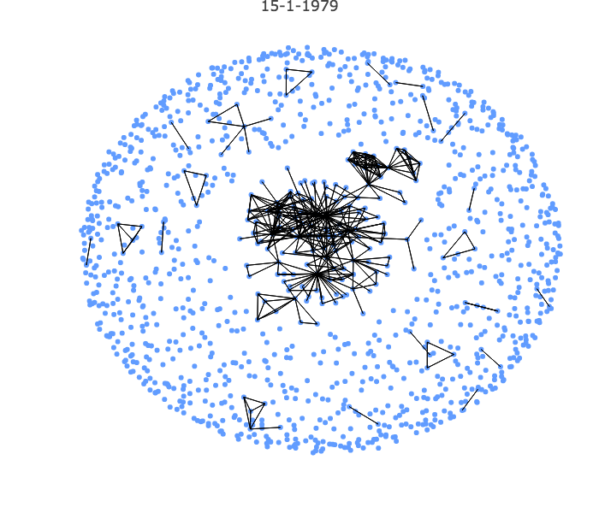

Slide 39
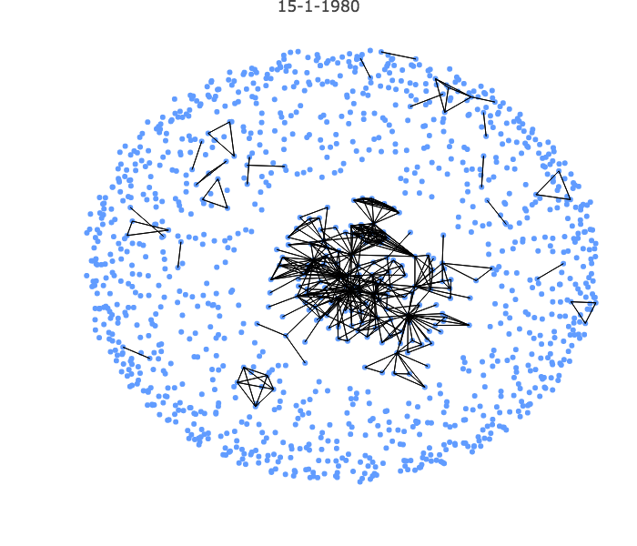

Slide 40
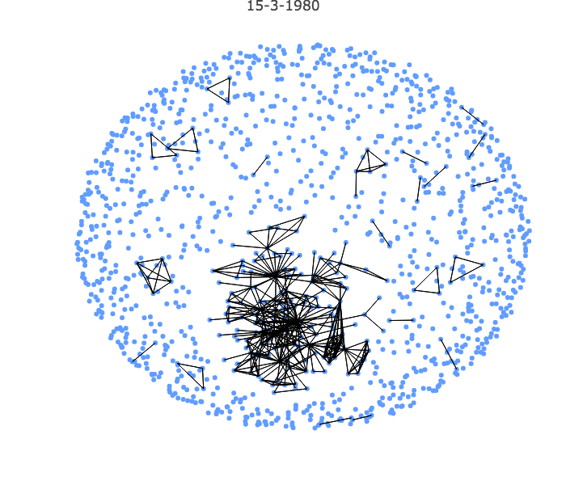

Slide 41
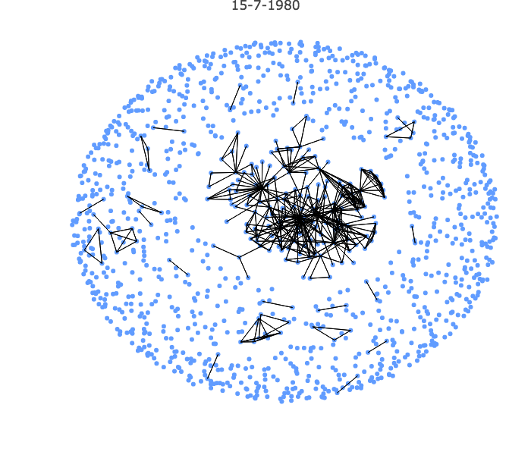

Slide 42
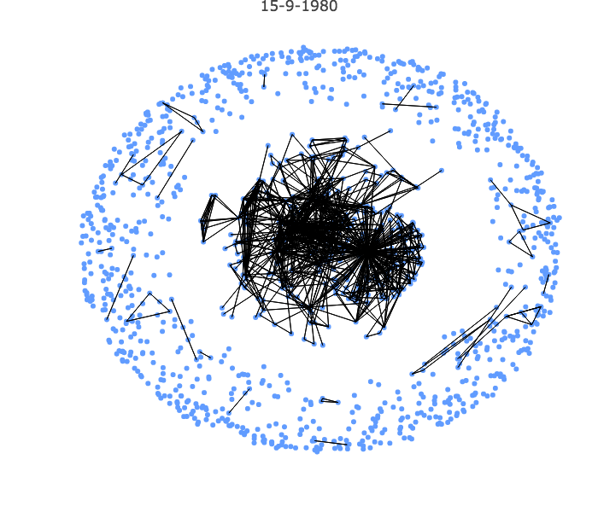

Slide 43
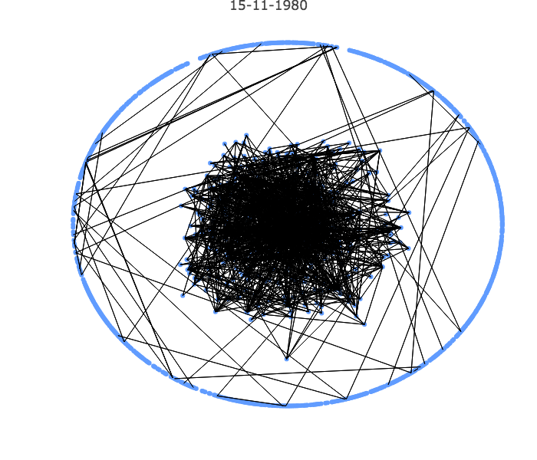

Slide 44
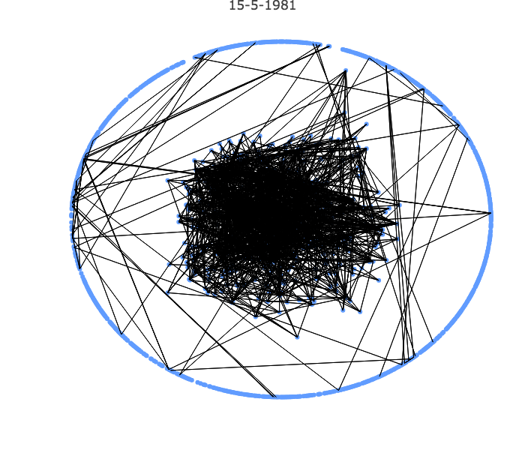

Slide 45
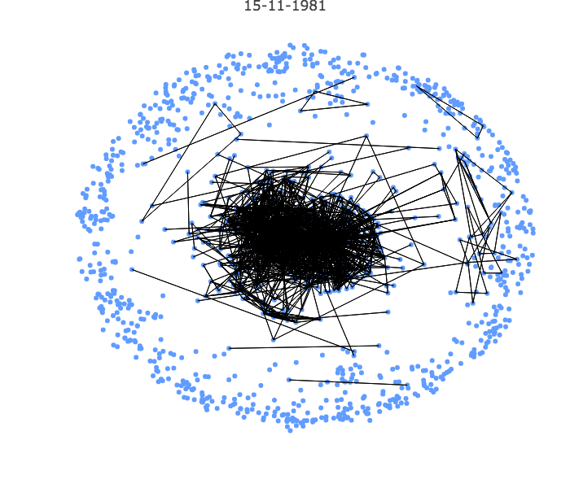

Slide 46
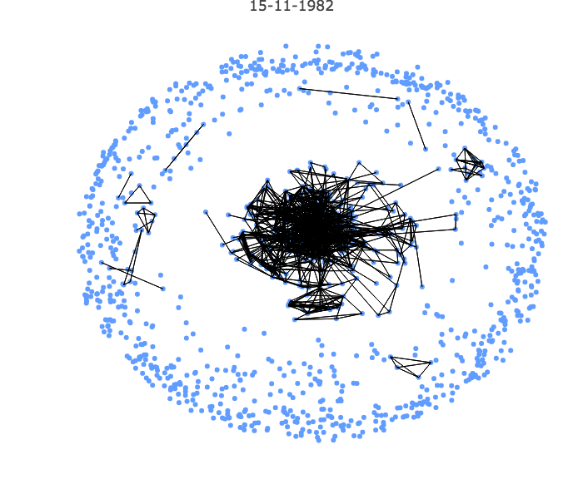

Slide 47
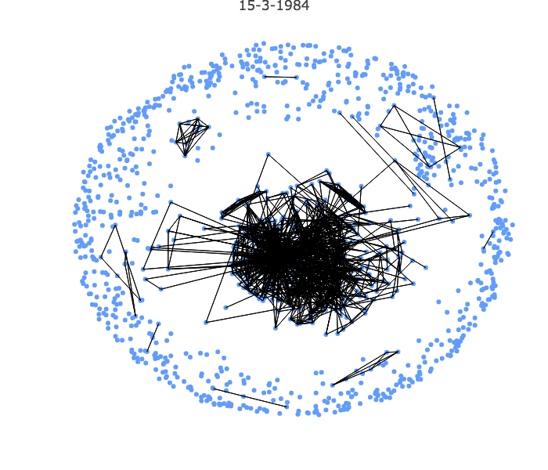

Slide 48
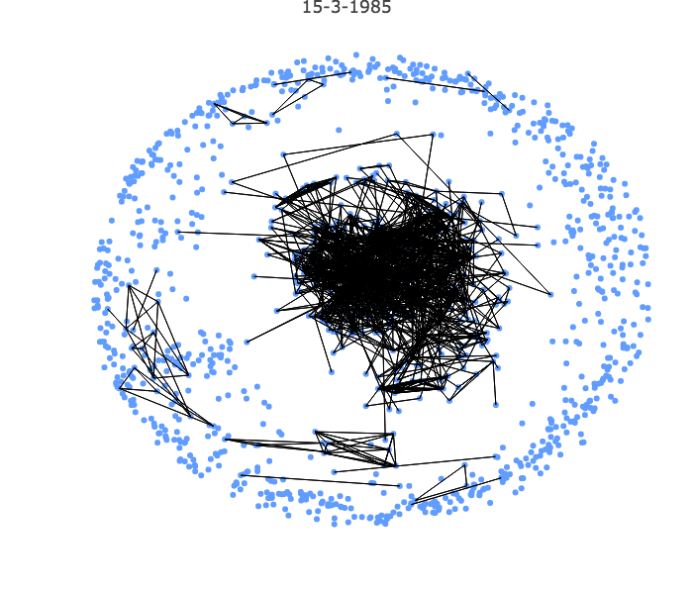

Slide 49
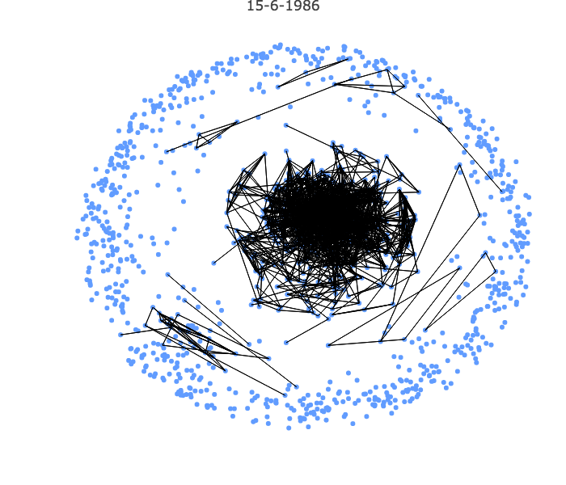

Slide 50
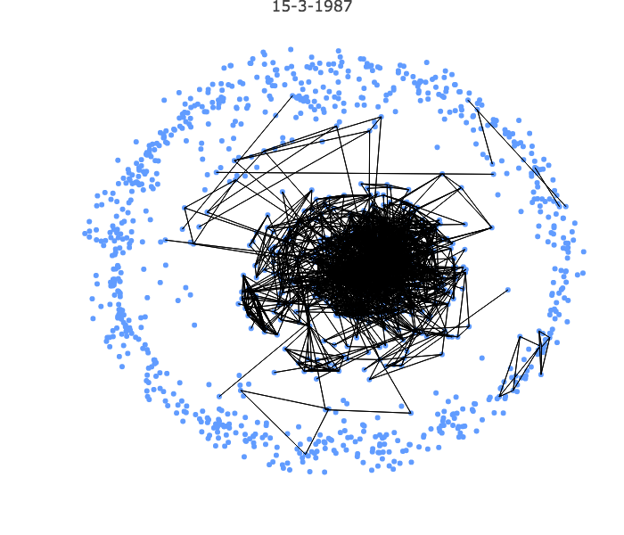

Slide 51
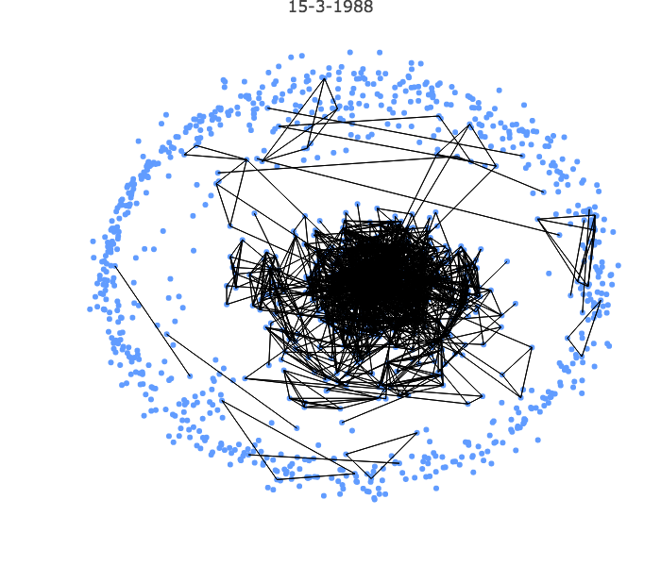

Slide 52
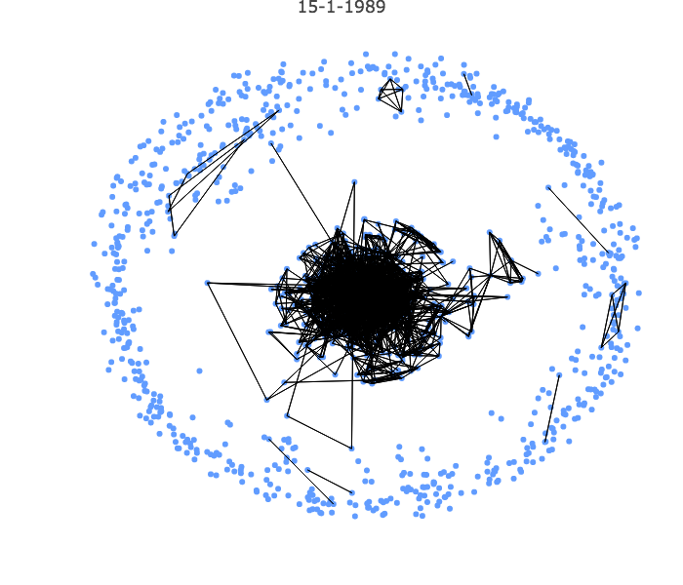

Slide 53
Ford Foundation Exchange Program, 1957-1962, 1967-1969
Run by Shepard Stone
Earliest exchange program, in the aftermath of Poznan 1956
~330 participants from Poland to the US, UK, Germany, France, and Switzerland (1957-1962)
~45 participants from Poland to US (1967-1969)
Humanities and Social Sciences
Notes:
Go over some of the details of the Ford Program. Then go into an exploration of the individuals who

Slide 54
Ford Foundation Grantees and the Round Table: The Big Picture
Thirteen grantees participate in the Round Table Negotiations, seven with the opposition:
Paweł Czartoryski
Stanisław Juchnowicz
Jan Mujżel
Jan Józef Szczepański
Adam Stanowski
Witold Trzeciakowski
Janusz Ziołkowski
Notes:
After this go and look at some visualizations to show the role of the exchange participants who were also round table participants

Slide 55
Paweł Czartoryski

Slide 56
Paweł Czartoryski

Slide 57
Paweł Czartoryski

Slide 58
Paweł Czartoryski

Slide 59
Paweł Czartoryski

Slide 60
Adam Stanowski

Slide 61
Adam Stanowski

Slide 62
Adam Stanowski

Slide 63
Adam Stanowski

Slide 64
Adam Stanowski

Slide 65
Adam Stanowski

Slide 66
Adam Stanowski

Slide 67
Jan Mujżel

Slide 68
Jan Mujżel

Slide 69
Jan Mujżel

Slide 70
Jan Mujżel

Slide 71
Jan Mujżel

Slide 72
Jan Mujżel

Slide 73
Further Steps
Tentative Findings
Create an IA network for the Government side of the RT talks
Create IA information for exchange participants
Increase functionality of the app, with filters, etc.
Create databases for other exchange programs, compare
Participation in the opposition driven by domestic events, not participation in exchange programs
IA’s useful for development of opposition culture
Can provide insights to focus qualitative research on changes in identity and personal transformation

